Slide 1
Cosmos Big Data at Microsoft
SAVEEN REDDY
2014/02/17
(Modified by Nabeel Kaushal – 2014/03/17)

Slide 2
About this Presentation
Target Audience
New to Cosmos
Just getting Started
Have heard of Big Data
Presenter
Used Cosmos for a long time
Very involved in usage & Best Practices
Source
http://aka.ms/Cosmos
→ Training
→ Cosmos Bootcamp
Very involved in usage & Best Practices
Notes:
Our mission in COSMOS is as a facilitator for enabling teams to create, organize, share and use Big Data easily, efficienctly and at low cost.
Some guiding principles –
Data sharing is a core principle – Having all the data assets available in a single location facilitates sharing
parallel computing – is HARD and we strive to make it approachable, Rather than having developers focus on physical execution plans – we made a call to build a state of the art optimizer to auto parallelize workloads – and a scheduler that abstracts the underlying infrastructure
BIG Data Processing – Can mean BIG Dollars. So we strive to maximize utilization of all resources all the time – Large clusters, sharing by reference vs. copying, designing for Hot data not cold & running multiple workloads on the same hardware

Slide 3
What is COSMOS
A reliable big data storage and distributed data processing product.
Storage
Data is replicated on the backend (but within one Datacenter)
Compressed automatically, so Physical size < Logical size
Big – GiB, TiB, PiB (net amount of data is Exabyte-scale).
Data Processing
Processing on multiple machines
Based on your type of query, team allocation, general state of COSMOS.

Slide 4
Promise
Enable customers to transform data of any scale into new business assets easily at low cost in the cloud
Notes:
Our mission in COSMOS is as a facilitator for enabling teams to create, organize, share and use Big Data easily, efficienctly and at low cost.
Some guiding principles –
Data sharing is a core principle – Having all the data assets available in a single location facilitates sharing
parallel computing – is HARD and we strive to make it approachable, Rather than having developers focus on physical execution plans – we made a call to build a state of the art optimizer to auto parallelize workloads – and a scheduler that abstracts the underlying infrastructure
BIG Data Processing – Can mean BIG Dollars. So we strive to maximize utilization of all resources all the time – Large clusters, sharing by reference vs. copying, designing for Hot data not cold & running multiple workloads on the same hardware

Slide 5
 | Guiding Principles
Shared Data as a Service | Unified repository of high value data assets (Documents/Entities/User Activity/People) Sharing by reference model (encourages experimentation between teams)
Approachable Compute | Lower the barrier to write efficient programs - Auto parallelize Optimize execution for underlying infrastructure; Isolate Users from Hardware failures Provide a natural evolution for SQL and .NET Programmers
Scale at Lowest Cost | Large shared processing/storage clusters Optimize for maximizing utilization
Service Model | Easy to Manage and Operate for customers and Cosmos Team No operations team (DRI Model)

Slide 6
Ecosystem
Bing Ad Center, MSN, Maps, Windows Phone, Xbox live, Windows Live, …
5K+
Developers
100s
Feature Teams
1K+
Virtual Clusters

Slide 7
How Customers Use Cosmos

Slide 8
Log Processing
m1
m2
m3
m4
m5
m6
Front-End Machines
Logs
Logs
Logs
Logs
Logs
Logs
Cosmos
Raw Log Data
Cooked Log Data
Cleanup, Join, Remove Duplicates

Slide 9
Data Mining
Perform traditional analysis/reporting on large datasets
Cooked Log Data
System/ Operational Analytics
Flight analysis
Usage Trends

Slide 10
Curating Data
Generally back-end processing of served data
Bing Front End
Online System
(example: Bing)
Bing Index
Cosmos
Catalogs & Index
Process and Update
(bing index, social graph, etc.)

Slide 11
Machine learning & Training
Scale out training algorithms over massive training data sets
Massive Data Set
Spam Samples
Speech Samples
Training
Training
Machine
Learning
Models
Spam Detection
Algorithms
Speech Recognition Algorithms

Slide 12
Cosmos 101

Slide 13
How do you Reliably Store 700TB of Data?
Notes:
Our mission in COSMOS is as a facilitator for enabling teams to create, organize, share and use Big Data easily, efficienctly and at low cost.
Some guiding principles –
Data sharing is a core principle – Having all the data assets available in a single location facilitates sharing
parallel computing – is HARD and we strive to make it approachable, Rather than having developers focus on physical execution plans – we made a call to build a state of the art optimizer to auto parallelize workloads – and a scheduler that abstracts the underlying infrastructure
BIG Data Processing – Can mean BIG Dollars. So we strive to maximize utilization of all resources all the time – Large clusters, sharing by reference vs. copying, designing for Hot data not cold & running multiple workloads on the same hardware

Slide 14
Cosmos stores data as Streams – a file-like structure
Behind the scenes
Streams are split apart into Extents
Each Extent can be up to 250MB in size
For availability and reliability Extents are replicated (3 copies)
700TB
1
2
3
4
5
6
7
8
9
10
1
2
3
4
5
6
7
8
9
10
1
2
3
4
5
6
7
8
9
10
1
2
3
4
5
6
7
8
9
10

Slide 15
Getting data into Cosmos

Slide 16
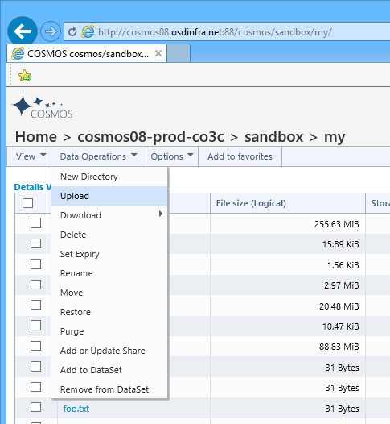
Multiple Options
Web UI
Cosmos VcClient API
VcClient.VC.Setup(
"vc://cosmos08/sandbox",
null,
null);
string filename = @"D:\data.txt";
string streamname = @"/my/data.txt";
bool compression = true;
VcClient.VC.Upload(
filename,
streamname,
compression);
Scope Studio
A Visual Studio plugin
Cosmos PowerShell Import-Module CosmosPS Import-CosmosStreamFromFile d:\data.txt vc://cosmosos/sandbox/my
SCOPE.EXE scope.exe copy d:\data.txt vc://cosmos08/sandbox/my
Notes:
Our mission in COSMOS is as a facilitator for enabling teams to create, organize, share and use Big Data easily, efficienctly and at low cost.
Some guiding principles –
Data sharing is a core principle – Having all the data assets available in a single location facilitates sharing
parallel computing – is HARD and we strive to make it approachable, Rather than having developers focus on physical execution plans – we made a call to build a state of the art optimizer to auto parallelize workloads – and a scheduler that abstracts the underlying infrastructure
BIG Data Processing – Can mean BIG Dollars. So we strive to maximize utilization of all resources all the time – Large clusters, sharing by reference vs. copying, designing for Hot data not cold & running multiple workloads on the same hardware

Slide 17
Cosmos Data Loader
By Volume most data comes into Cosmos via Cosmos Data Loader (CDL)
There are two versions of CDL: CDLv1 and CDLv2 – use CDLv2
Machine 1
LOG
CDL
STREAM
Machine 2
LOG
CDL
Machine 2
LOG
CDL
Notes:
Our mission in COSMOS is as a facilitator for enabling teams to create, organize, share and use Big Data easily, efficienctly and at low cost.
Some guiding principles –
Data sharing is a core principle – Having all the data assets available in a single location facilitates sharing
parallel computing – is HARD and we strive to make it approachable, Rather than having developers focus on physical execution plans – we made a call to build a state of the art optimizer to auto parallelize workloads – and a scheduler that abstracts the underlying infrastructure
BIG Data Processing – Can mean BIG Dollars. So we strive to maximize utilization of all resources all the time – Large clusters, sharing by reference vs. copying, designing for Hot data not cold & running multiple workloads on the same hardware

Slide 18
The Basic Workflow

Slide 19
Submitting a Job
Scope is our language.
Submit a Scope script to your Virtual Cluster.
A Job is Started that will run that script.
At some point later the Job completes.
Jobs can take 20 seconds or Days depending on how much data you are processing.
Your Virtual Cluster
Job
RawData.CSV
Data.CSV
Upload
Submit
Download
Scope Script
RawData.CSV
Data.CSV
Notes:
Our mission in COSMOS is as a facilitator for enabling teams to create, organize, share and use Big Data easily, efficienctly and at low cost.
Some guiding principles –
Data sharing is a core principle – Having all the data assets available in a single location facilitates sharing
parallel computing – is HARD and we strive to make it approachable, Rather than having developers focus on physical execution plans – we made a call to build a state of the art optimizer to auto parallelize workloads – and a scheduler that abstracts the underlying infrastructure
BIG Data Processing – Can mean BIG Dollars. So we strive to maximize utilization of all resources all the time – Large clusters, sharing by reference vs. copying, designing for Hot data not cold & running multiple workloads on the same hardware

Slide 20
Daily Logs
Some teams keep a separate log file for each day
Your Virtual Cluster
Job
Multiple CSVs
One for each day
Today.CSV
OneWeek.CSV
Upload
Download
Submit
Scope Script
Today.CSV
OneWeek.CSV
Notes:
Our mission in COSMOS is as a facilitator for enabling teams to create, organize, share and use Big Data easily, efficienctly and at low cost.
Some guiding principles –
Data sharing is a core principle – Having all the data assets available in a single location facilitates sharing
parallel computing – is HARD and we strive to make it approachable, Rather than having developers focus on physical execution plans – we made a call to build a state of the art optimizer to auto parallelize workloads – and a scheduler that abstracts the underlying infrastructure
BIG Data Processing – Can mean BIG Dollars. So we strive to maximize utilization of all resources all the time – Large clusters, sharing by reference vs. copying, designing for Hot data not cold & running multiple workloads on the same hardware

Slide 21
Daily Logs with a Snapshot
Some teams keep a snapshot of data that is very large and keep incorporating each days data.
Your Virtual Cluster
Job
OneYear.CSV
NewOneYear.CSV
Analysis.CSV
Today.CSV
Job
Upload
Download
Submit
Submit
Scope Script
Scope Script
Today.CSV
Analysis.CSV
Notes:
Our mission in COSMOS is as a facilitator for enabling teams to create, organize, share and use Big Data easily, efficienctly and at low cost.
Some guiding principles –
Data sharing is a core principle – Having all the data assets available in a single location facilitates sharing
parallel computing – is HARD and we strive to make it approachable, Rather than having developers focus on physical execution plans – we made a call to build a state of the art optimizer to auto parallelize workloads – and a scheduler that abstracts the underlying infrastructure
BIG Data Processing – Can mean BIG Dollars. So we strive to maximize utilization of all resources all the time – Large clusters, sharing by reference vs. copying, designing for Hot data not cold & running multiple workloads on the same hardware

Slide 22
Interactive
If you are performing very aggregated queries, we have a method of getting interactive (1 second) response times.
This is called iScope – it uses a subset of the Scope language.
Big growth area for us.
Your Virtual Cluster
Data.ss
Execute
iScope API
ODBC Driver Enables direct access via BI Tools
Excel
SSRS
Notes:
Our mission in COSMOS is as a facilitator for enabling teams to create, organize, share and use Big Data easily, efficienctly and at low cost.
Some guiding principles –
Data sharing is a core principle – Having all the data assets available in a single location facilitates sharing
parallel computing – is HARD and we strive to make it approachable, Rather than having developers focus on physical execution plans – we made a call to build a state of the art optimizer to auto parallelize workloads – and a scheduler that abstracts the underlying infrastructure
BIG Data Processing – Can mean BIG Dollars. So we strive to maximize utilization of all resources all the time – Large clusters, sharing by reference vs. copying, designing for Hot data not cold & running multiple workloads on the same hardware

Slide 23
Submitting a Job

Slide 24
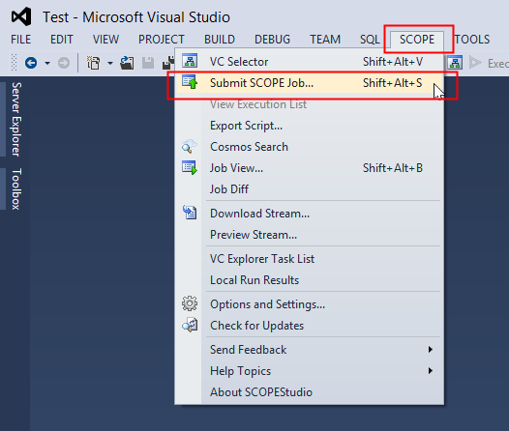
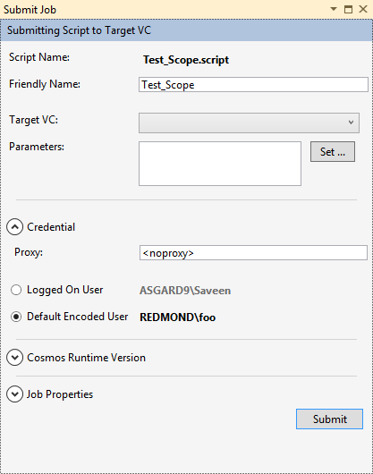
Scope Studio
An Add-In for Visual Studio 2012 and Visual Studio 2013
Notes:
Our mission in COSMOS is as a facilitator for enabling teams to create, organize, share and use Big Data easily, efficienctly and at low cost.
Some guiding principles –
Data sharing is a core principle – Having all the data assets available in a single location facilitates sharing
parallel computing – is HARD and we strive to make it approachable, Rather than having developers focus on physical execution plans – we made a call to build a state of the art optimizer to auto parallelize workloads – and a scheduler that abstracts the underlying infrastructure
BIG Data Processing – Can mean BIG Dollars. So we strive to maximize utilization of all resources all the time – Large clusters, sharing by reference vs. copying, designing for Hot data not cold & running multiple workloads on the same hardware

Slide 25
Via Code
Cosmos PowerShell Submit-CosmosScopeJob d:\my.script vc://cosmos08/sandbox
SCOPE.EXE scope.exe submit –i d:\my.script vc://cosmos08/sandbox
Cosmos VCClient APIs VcClient.VC.Setup(
"vc://cosmos08/sandbox",
null,
null);
string script=“D:\\my.script”
var submit_params =
new ScopeClient.SubmitParameters(script_filename);
var job_info = ScopeClient.Scope.Submit(submit_params);
Notes:
Our mission in COSMOS is as a facilitator for enabling teams to create, organize, share and use Big Data easily, efficienctly and at low cost.
Some guiding principles –
Data sharing is a core principle – Having all the data assets available in a single location facilitates sharing
parallel computing – is HARD and we strive to make it approachable, Rather than having developers focus on physical execution plans – we made a call to build a state of the art optimizer to auto parallelize workloads – and a scheduler that abstracts the underlying infrastructure
BIG Data Processing – Can mean BIG Dollars. So we strive to maximize utilization of all resources all the time – Large clusters, sharing by reference vs. copying, designing for Hot data not cold & running multiple workloads on the same hardware

Slide 26
Clusters and Virtual Clusters

Slide 27
COSMOS Concepts – (Virtual) Clusters
Cluster – Huge physical set of machines.
Example: cosmos11, accessed at http://cosmos11.osdinfra.net:88/
Virtual Cluster – Encapsulation of <storage, computation> allocation given to a team within 1 cluster.
Computation – set # of tokens
Token – guarantee of an instance of computation
Teams often have multiple VCs.
Prod vs AdHoc processing
Proxy VC – to transfer data between clusters

Slide 28
Virtual Cluster
We do not reserve a set of machines.
Instead we assign you a virtual cluster with a number of tokens.
1 Token = a right to execute.
20 token allocation = you are guaranteed 20 nodes

Slide 29
Bonus Computing
What happens when you are using up all your tokens?
If there are idle machines, Cosmos will try to apply them to your processing.

Slide 30
How many tokens will my Job need
Calibration
On your VC, submit your Job a few times using no Bonus Tokens.
This establishes your baseline performance.
You have to tell us.
Communicated as a percentage of VC token allocation

Slide 31
Bonus tokens cause job execution time to vary
Time to Complete your Job
3 hours
Fewer
Bonus
tokens
1 hour
Day 1
Day 2

Slide 32
Sources of Variance
Bonus Tokens?
Data Size?
Data Skew?
Script Changed?
Job Submission Parameters?

Slide 33
Streams

Slide 34
COSMOS Concepts - Streams
Stream – A “file” in COSMOS.
http://cosmos11.osdinfra.net:88/cosmos/MVA.Paris.Prod.Adhoc/local/Queries.txt
Cluster – cosmos11
VC – MVA.Paris.Prod.Adhoc
Stream local path: /local/Queries.txt

Slide 35
COSMOS Concepts - Paths
Paths in COSMOS
Typically
/local/<CustomFolderStructure>
Share from another VC
/shares/<OtherVC>/<SharedFolder>
AdHoc script runs
/my – Every user gets 1TiB / cluster
/my = /users/<alias> - Accessible in all VCs in the cluster

Slide 36
Streams
Unstructured Streams
Plaintext (TSV, CSV, JSON, etc.)
Binary files can be used – dlls etc.
Most streams in Cosmos
No Schema stored in the Text – first row can’t contain schema information
Structured Streams
.SS Extension
Contains Schema Information
Layout is optimized for Performance and Optimization
We generally want teams to move to using structured streams
You CAN append to streams!
Via metadata operations
Via CDL
You CAN’T modify them in the middle.

Slide 37
Data Partitioning in Structured Streams
Imagine large stream that contains a column called Domain
And suppose we have three domains that show up.
a.com
b.com
c.com
Unstructured Stream
Domain is scattered across extents
Extent 1
Extent 2
Extent 3
a
a
a
b
b
c
b
c
c
Structured Stream
Partitioned by Domain
Records with same Domain placed on same extent
Extent 1
Extent 2
Extent 3
a
b
c
c
a
b
b
a
c

Slide 38
Compute Layer
Deep Dive

Slide 39
Scope Language
Influenced by SQL and relational concepts
Naturally parallelizable computation
Works great with .NET and C#
Extensible
Rowset variable
EXTRACT indicates use of Unstructured Stream
RawData =
EXTRACT
Clicks:int,
Domain:string
FROM @“RAWWEBDATA.TSV”
USING DefaultTextExtractor();
WebData =
SELECT *,
Domain.Trim().ToUpper() AS NormalizedDomain
FROM RawData;
OUTPUT WebData
TO “WEBDATA.TSV”
USING DefaultTextOutputter();
Schema
Name + type
The input TSV file
Built-in object for reading TSVs
Compute a new Column
Create one rowset (WebData) from another (RawData)
Write the data to an output TSV

Slide 40
Using Structured Streams
RawData =
EXTRACT
Clicks:int,
Domain:string
FROM @“RAWWEBDATA.TSV”
USING DefaultTextExtractor();
WebData =
SELECT *,
Domain.Trim().ToUpper() AS NormalizedDomain
FROM RawData;
OUTPUT WebData
TO SSTREAM “WEBDATA.ss”
CLUSTERED BY Domain
SORTED BY Domain DESC;
SSTREAM keyword indicates a Structured Stream will be created
OUTPUT.ss is the name of the output stream
Data will be partitioned on the Domain column
To enhance performance
Sorting also enabled
On the Domain column for performance

Slide 41
Reading from a Structured Stream
SSTREAM keyword indicates we will be reading from a structured stream
WebData = SSTREAM “WEBDATA.ss”;
No schema is specified because the structured stream contains it.

Slide 42
Find the top 100 Domains that users Clicked on
WebData = SSTREAM “WEBDATA.ss”;
a = SELECT Domain, COUNT(…) AS TotalClicks FROM WebData GROUP BY Domain;
b = SELECT TOP 100 Domain, TotalClicks
FROM a
ORDER BY TotalClicks;
OUTPUT b
TO SSTREAM “ANALYSIS.ss”
CLUSTERED BY Domain
SORTED BY Domain DESC;

Slide 43
WITH UNSTRUCTURED STREAMS
a.com
b.com
c.com
a.com
b.com
c.com
a.com
b.com
c.com
a.com
b.com
c.com
Domains are randomly scattered across extents
…
…
Read
Read
Read
Read
Within an Extent We can partially compute the aggregates
Partial Agg
Partial Agg
Partial Agg
Partial Agg
Put the data for each domain into the same place
Partition
Partition
Partition
Partition
EXPENSIVE
Now we can complete the aggregation per domain
Full Agg
Full Agg
Full Agg
EXPENSIVE
Sort
…
Sort
…
Sort
Sort the data
Top 100
Top 100
Top 100
Just get the top 100

Slide 44
WITH STRUCTURED STREAMS
The domains are partitioned into extents
a.com
b.com
c.com
c.com
…
…
No massive data shuffling
Read
Read
Read
Read
We can do the full aggregation immediately
Full Agg
Full Agg
Partial Agg
Partial Agg
Sort
Sort
Full Agg
Top 100
Top 100
Sort
c.com took spanned several extents
Top 100
Top 100

Slide 45
Data Skew
Relatively Even Partitioning
a
b
c
Uneven Partitioning – Data Skew
a
b
c

Slide 46
Job Execution

Slide 47
Computation
Write a SCOPE script
SCOPE – A proprietary sql-like language for querying data.
Scope script: Set of commands to process a set of inputs to a set of outputs.
Submit a script to a VC → a Job
Job – An execution work item in a VC
Queued → Running → Completed
Submit via ScopeStudio.

Slide 48
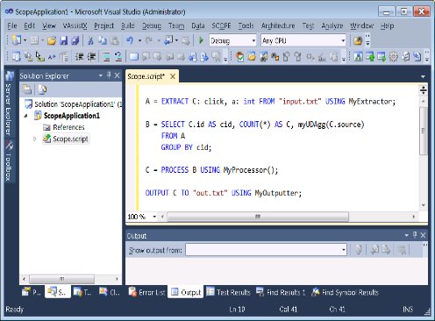
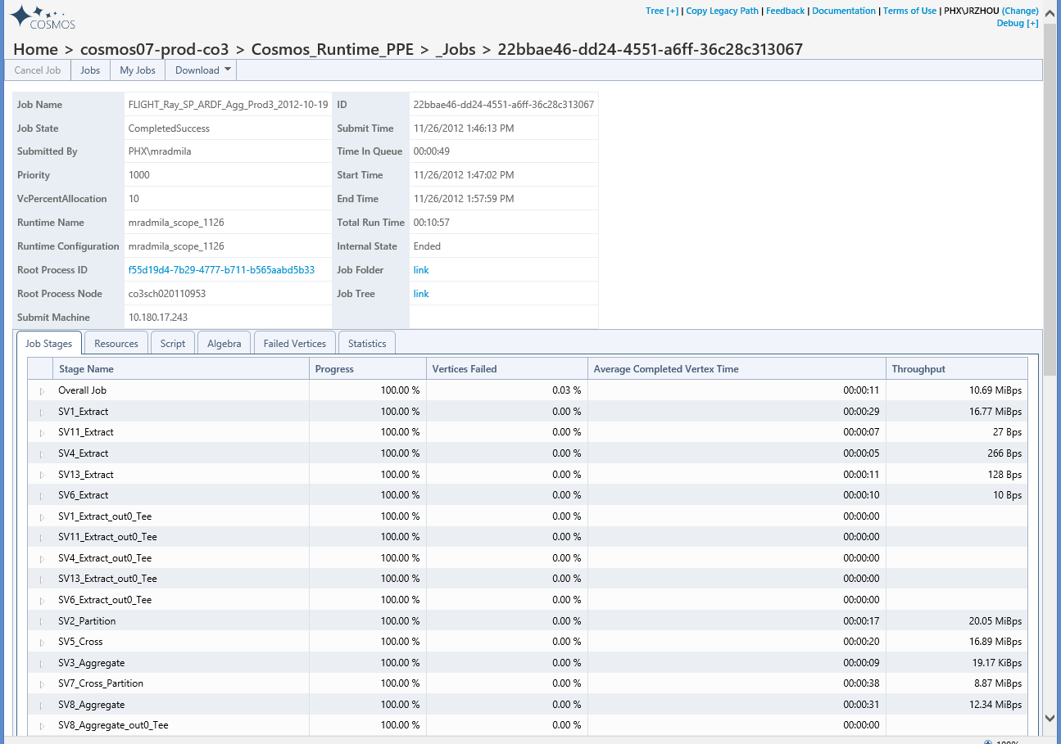
Query Life
Cosmos Front-End Service
Compiler
Optimizer
Scope Studio
. . .
…
…
…
. . .
Scheduler
Runtime
Web Interface / API

Slide 49
Wrap Up

Slide 50
Our website
http://aka.ms/Cosmos
Presentations
http://aka.ms/CosmosPresentations
Scope Tutorial
http://aka.ms/ScopeTutorial
Scope Studio
http://aka.ms/ScopeStudioInstall
Request access to sandbox
http://aka.ms/CosmosSandbox
Yammer Group
http://aka.ms/CosmosYammer
Join the discussion
cosmdisc@microsoft.com
Get Cosmos Announcements
cosmosan@microsoft.com

Slide 51
Questions

Slide 52
Backup

Slide 53
Demo

Slide 54
Search log represents a users activity a session in Bing for a query
searchlog =
EXTRACT
IId:int,
UId:int,
Start:DateTime,
Market:string,
Query:string,
DwellTime:int,
Results:string,
ClickedUrls:string
FROM
@"/my/ScopeTutorial/SampleInputs/SearchLog.txt"
USING
DefaultTextExtractor();
OUTPUT searchlog
TO @"/my/ScopeTutorial/SampleOutputs/SearchLog.txt";

Slide 55
Demo Topics
Scope Studio
Authoring
.NET Integration
Job Submission
Interactive Big Data (iScope)
A Sample Application
Job Analysis
Plan
Diff
Recurrence

Slide 56
Scope
wiki = SSTREAM @"/shares/cosmosAdmin/iScopeCosting/WikipediaWordCount.ss";
rs = SELECT TOP 100 *
FROM wiki
WHERE keyword == "bing";
OUTPUT rs TO @"/my/demo-wikipedia.txt" USING DefaultTextOutputter();
Notes:
Our mission in COSMOS is as a facilitator for enabling teams to create, organize, share and use Big Data easily, efficienctly and at low cost.
Some guiding principles –
Data sharing is a core principle – Having all the data assets available in a single location facilitates sharing
parallel computing – is HARD and we strive to make it approachable, Rather than having developers focus on physical execution plans – we made a call to build a state of the art optimizer to auto parallelize workloads – and a scheduler that abstracts the underlying infrastructure
BIG Data Processing – Can mean BIG Dollars. So we strive to maximize utilization of all resources all the time – Large clusters, sharing by reference vs. copying, designing for Hot data not cold & running multiple workloads on the same hardware

Slide 57
iScope
wiki = SSTREAM @"/shares/cosmosAdmin/iScopeCosting/WikipediaWordCount.ss";
rs = SELECT TOP 100 *
FROM wiki
WHERE keyword == "bing";
OUTPUT rs TO CONSOLE;
Notes:
Our mission in COSMOS is as a facilitator for enabling teams to create, organize, share and use Big Data easily, efficienctly and at low cost.
Some guiding principles –
Data sharing is a core principle – Having all the data assets available in a single location facilitates sharing
parallel computing – is HARD and we strive to make it approachable, Rather than having developers focus on physical execution plans – we made a call to build a state of the art optimizer to auto parallelize workloads – and a scheduler that abstracts the underlying infrastructure
BIG Data Processing – Can mean BIG Dollars. So we strive to maximize utilization of all resources all the time – Large clusters, sharing by reference vs. copying, designing for Hot data not cold & running multiple workloads on the same hardware

Slide 58
Scope Studio
(Add-In for Visual Studio)

Slide 59
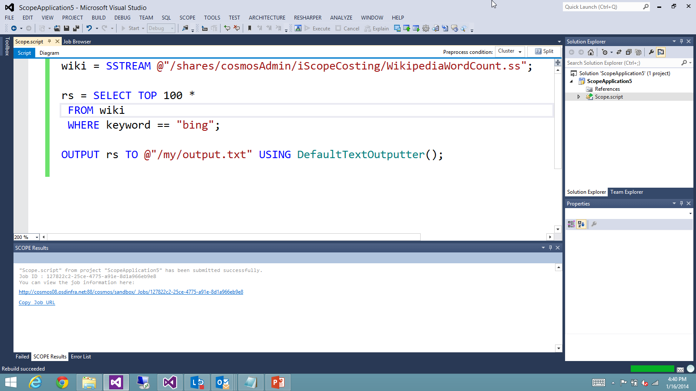

Slide 60
Scope Studio
Job Profile Animation

Slide 61
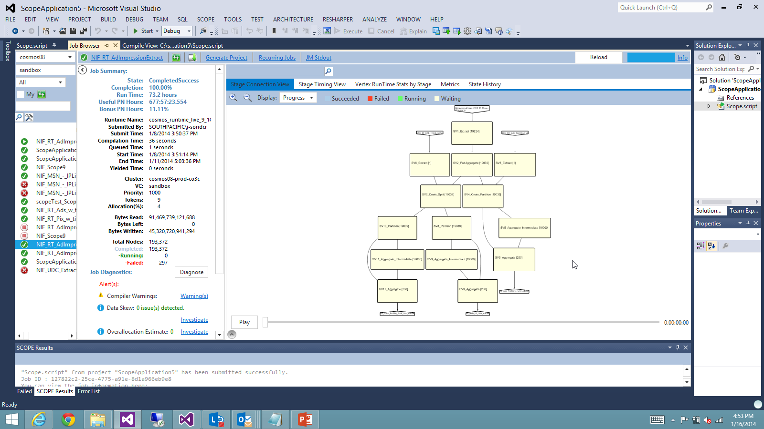

Slide 62
Scope Studio
Job Diff

Slide 64
Recurring Job Analysis

Slide 65
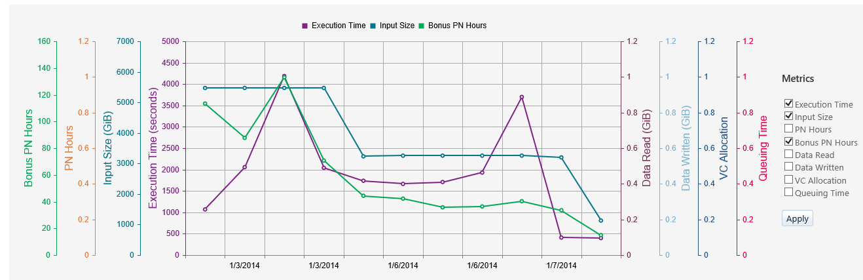

Slide 66
Manage Storage Capacity

Slide 67
Geo-Replication
high-value datasets are copied (geo-replicated) between clusters for Availability and Business Continuity
Chicago
San Antonio
Notes:
Our mission in COSMOS is as a facilitator for enabling teams to create, organize, share and use Big Data easily, efficienctly and at low cost.
Some guiding principles –
Data sharing is a core principle – Having all the data assets available in a single location facilitates sharing
parallel computing – is HARD and we strive to make it approachable, Rather than having developers focus on physical execution plans – we made a call to build a state of the art optimizer to auto parallelize workloads – and a scheduler that abstracts the underlying infrastructure
BIG Data Processing – Can mean BIG Dollars. So we strive to maximize utilization of all resources all the time – Large clusters, sharing by reference vs. copying, designing for Hot data not cold & running multiple workloads on the same hardware

Slide 68
The SCOPE Compiler and Optimizer
The SCOPE Compiler and Optimizer take SCOPE programs and create:
The algebra describing the computation
The breakdown of the work into processing units
The description of the inputs and outputs from the processing units
Many decisions about compiling and optimizing are driven by data size and minimizing data movement
SCOPE Layer
Data = SELECT * FROM S WHERE Col-1 > 10
SCOPE
Compiler
SCOPE
Optimizer

Slide 69
Cosmos & Azure
Not much in terms of native support
Azure based teams are recent customers of Cosmos
Working on improving the story in 2013
If direct connectivity is possible/preferred
Open connectivity to Cosmos back end
Requires engaging with Azure using steps here
Open ACLs for every Azure VIP to Cosmos
Cosmos can open ACLs for VIPs
Not recommended due to dynamic VIPs on Azure
If direct connectivity isn't possible
Create intermediate service within GFS domain
Requires custom work on your part

